Slide 1


Python Data Structures: Sets & Dictionaries
A beginner's guide to understanding sets, dictionaries, and when to use each one.

Slide 2

What Is a Set?
Unique Elements Only
How to Create One
Unordered, mutable collection — duplicates are automatically removed when added.
my_set = {1, 2, 3}
or
set([1, 2, 2, 3]) → {1, 2, 3}
No Indexing
Cannot be indexed — use loops or membership tests with in to access elements.

Slide 3





Core Set Operations
Union — A | B
Intersection — A & B
All elements from both sets combined.
Only elements that appear in both sets.
Difference — A - B
Symmetric Difference — A ^ B
Elements in A but not in B.
Elements in either, but not both.

Slide 4


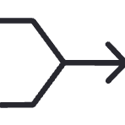

Set Methods in Action
.add(x)
.remove(x) / .discard(x)
Add a single element to the set.
.remove(x) raises an error if missing. Use .discard(x) to avoid errors safely.
Operator Methods
.issubset() / .issuperset()
.union(), .intersection(), .difference() — method equivalents of |, &, -.
Check containment relationships between two sets.

Slide 5

When to Use a Set
1
Remove Duplicates
2
Fast Membership Testing
Turn any list into unique items instantly:
unique = list(set(my_list))
O(1) lookup speed vs O(n) for lists — sets are dramatically faster for in checks.
3
Compare Collections
Find common or unique items between two groups using union, intersection, or difference.

Slide 6
List vs Tuple vs Set vs Dict
Type
Ordered?
Mutable?
Duplicates?
Best For
List
✅ Yes
✅ Yes
✅ Yes
Sequences you'll modify
Tuple
✅ Yes
❌ No
✅ Yes
Fixed data (coords, RGB)
Set
❌ No
✅ Yes
❌ No
Unique items & fast lookup
Dict
✅ Yes*
✅ Yes
Keys: No
Labeled / structured data
*Dicts preserve insertion order in Python 3.7+

Slide 7



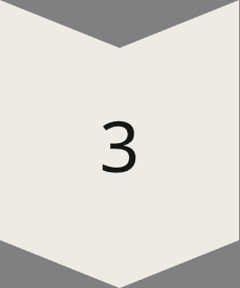
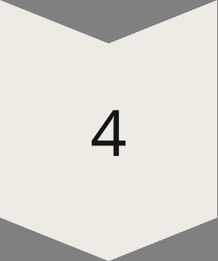

Choosing the Right Structure
Order + Mutability?
→ Use a List
Order + Immutability?
→ Use a Tuple
Uniqueness + Speed?
→ Use a Set
Labeled Data?
→ Use a Dict
When in doubt: if you're storing pairs of related info, use a dict; if you just need a bag of unique items, use a set.

Slide 8

What Is a Dictionary?
Key-Value Pairs
Keys Must Be Unique
Each key maps to a value:
{"name": "Alice", "age": 25}
Keys are unique and immutable — strings, numbers, and tuples are valid key types.
Values Are Flexible
Values can be any type — strings, lists, numbers, or even other dictionaries.

Slide 9

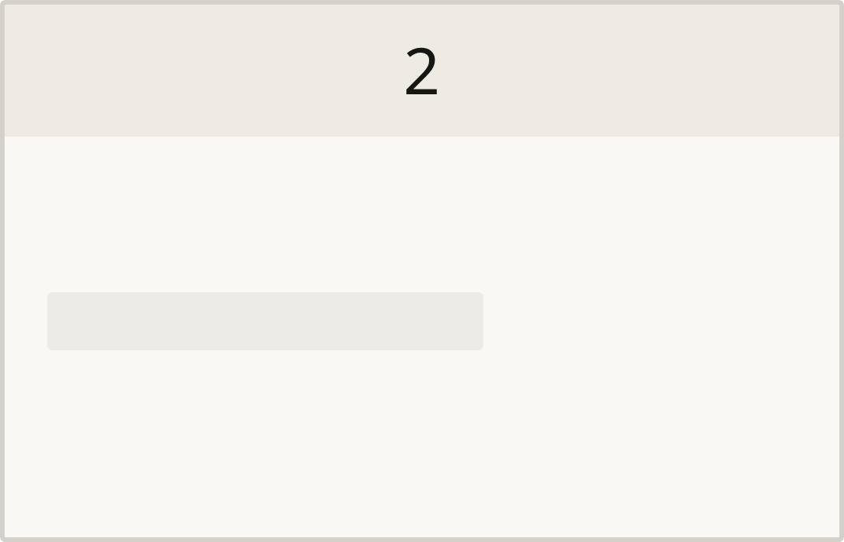

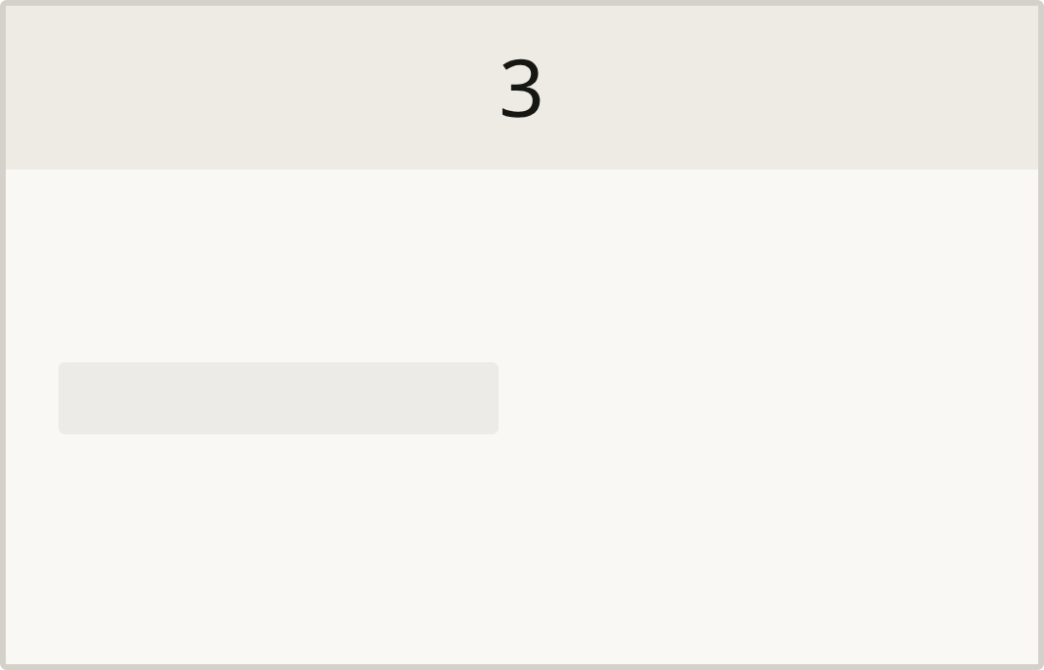
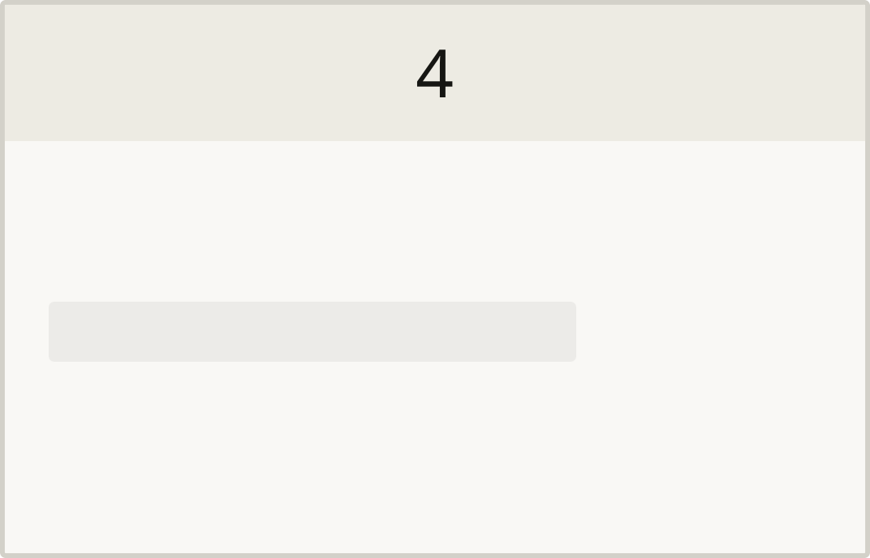
Accessing & Modifying Dicts
Direct Access
Safe Access
dict["key"] — returns the value, but raises KeyError if the key doesn't exist.
dict.get("key", default) — returns the fallback value instead of crashing.
Add or Update
Merge Dicts
dict["key"] = value — creates a new key or overwrites an existing one.
dict.update({"key": value}) — merges another dictionary into the current one.

Slide 10





Essential Dict Methods
.keys()
.values()
.items()
Returns a view of all keys in the dictionary.
Returns a view of all values in the dictionary.
Returns all key-value pairs as tuples — the most versatile method.
.pop("key")
"key" in dict
Removes and returns the value for the given key.
Check if a key exists — O(1) speed, just like sets.

Slide 11
Iterating Over a Dictionary
Three Iteration Patterns
Example: .items() in action
01
student = {
"name": "Alice",
"grade": "A",
"score": 95
}
for key, value in student.items():
print(f"{key}: {value}")
# Output:
# name: Alice
# grade: A
# score: 95
Keys only (default)
for key in dict:
02
Keys + Values (most common)
for key, value in dict.items():
03
Values only
for value in dict.values():

Slide 12

Nested Dictionaries
Dicts inside Dicts
students = {
"Alice": {
"grade": "A",
"score": 95
},
"Bob": {
"grade": "B",
"score": 82
},
"Carol": {
"grade": "A",
"score": 91
}
}
# Access nested value
print(students["Alice"]["score"])
# Output: 95
# Safe access with .get()
grade = students.get("Bob", {}).get("grade", "N/A")
print(grade) # Output: B
Values can themselves be dictionaries — perfect for structured records like a student database.
Access nested values by chaining keys:
data["user"]["email"]
Use .get() at each level to avoid KeyError on missing nested keys.

Slide 13

Nested Lists in Dictionaries
One-to-Many Relationships
Appending to a Nested List
Add new items directly using .append():
Values can be lists — store multiple items under a single key:
dict["fruits"].append("mango")
{"fruits": ["apple", "banana"],
"veggies": ["carrot"]}
Iterating Over Nested Lists
Loop through the inner list just like any other:
for item in dict["fruits"]:
print(item)

Slide 14
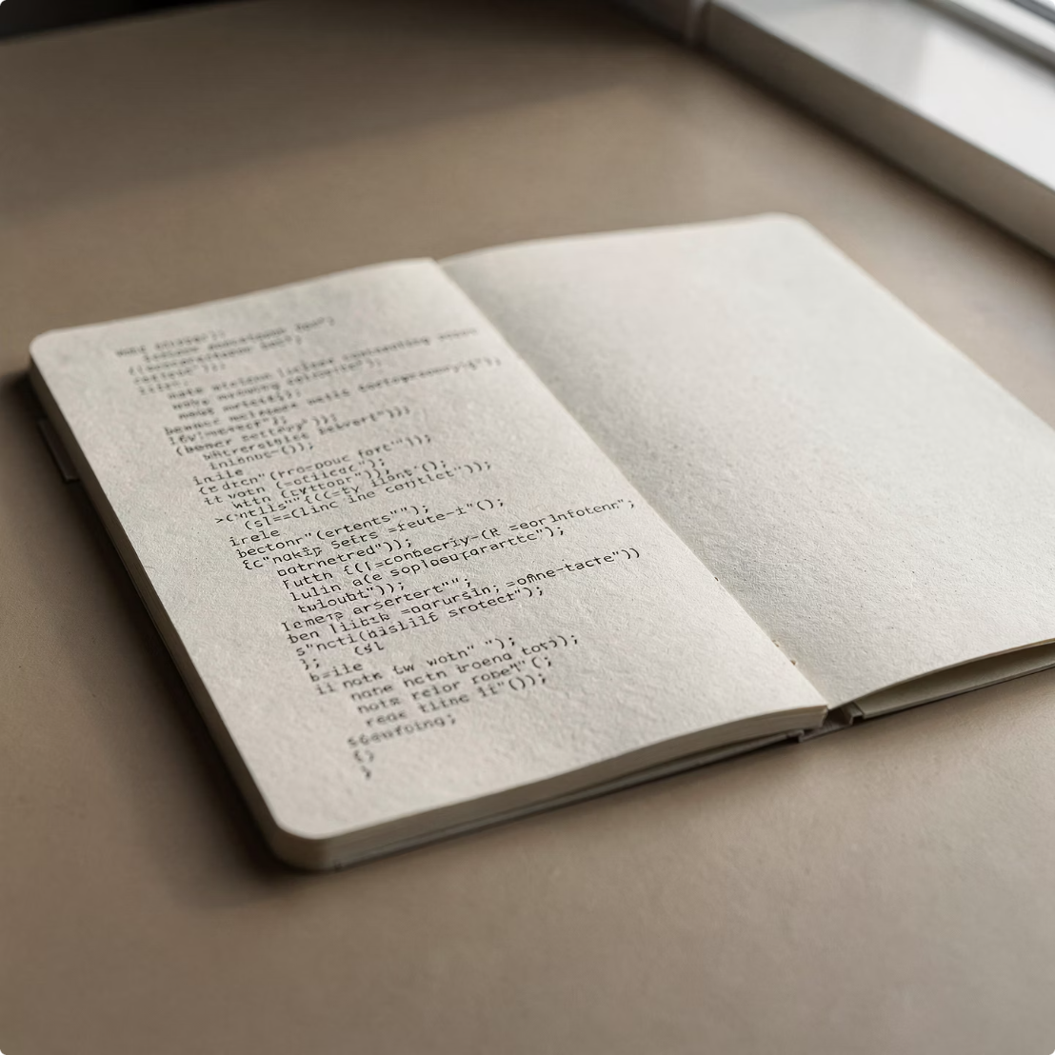


Dict Comprehensions
Build Dicts in One Line
Basic Comprehension
Filter While Building
Transform Values
{name: score * 2
for name, score in scores.items()}
{k: v for k, v in pairs}
{k: v for k, v in d.items() if v > 0}
Constructs a dict from any iterable of key-value pairs.
Only include entries that pass the condition.
Apply any expression to transform each value on the fly.

Slide 15

Sets vs Dicts — Easy to Confuse!
The Trap 🪤
Side-by-Side Comparison
Both use { } curly braces — but they behave very differently. This trips up almost every beginner!
Expression
What it creates
{}
Empty dict ⚠️
set()
Empty set ✅
The Golden Rule
{1, 2, 3}
Set — no colons
Look for colons. If you see key: value pairs, it's a dict. No colons? It's a set.
{"a": 1}
Dict — has colons
{"a": 1, "b": 2}
Dict — has colons
{"a", "b", "c"}
Set — no colons
Writing {} creates an empty dict, NOT an empty set. Always use set() for an empty set!

Slide 16

Quick Reference: Sets & Dicts
Sets 🔵
Dicts 🟡
Unique items, no duplicates
Fast O(1) lookup
Union |, Intersection &, Difference -
Create: {1, 2, 3} or set()
Empty set: set() — never {}
Labeled key-value data
Safe access: .get("key", default)
Iterate pairs: .items()
Supports nesting: dicts & lists as values
Empty dict: {}
O(1)
4
5
Set Lookup
Data Structures
Dict Methods
Constant time membership test
List, Tuple, Set, Dict
get, update, keys, values, items
You now have the tools to choose the right structure every time. When in doubt: pairs → dict, unique items → set!

